Slide 1
Chapter 14
Lambda Expressions and Method References
李晔锋

Slide 2
Key Skills & Concepts
Know the general form of a lambda expression
Understand the definition of a functional interface
Use expression lambdas
Use block lambdas
Use generic functional interfaces
Understand variable capture in a lambda expression
Throw an exception from a lambda expression
Understand the method reference
Understand the constructor reference
Know about the predefined functional interfaces in java.util.function
Learn about Stream

Slide 3
Introducing Lambda Expressions
A lambda expression is, essentially, an anonymous (that is, unnamed) method. However, this method is not executed on its own. Instead, it is used to implement a method defined by a functional interface.
A functional interface is an interface that contains one and only one abstract method. It is sometimes referred to as a SAM type, where SAM stands for Single Abstract Method.

Slide 4
Functional Interfaces
Functional interface is the basis of using a lambda expression. Suppose the following functional interface is defined:
interface MyInterface {
double getValue();
}

Slide 5
Implementing the Interface
1. Create a class that implementing the interface, then initiate the reference to the interface in other place.
class MyImpl implements MyInterface {
@Override
public double getValue() {
// TODO Auto-generated method stub
return 98.0;
}
}
Then in the main class:
MyInterface if1 = new MyImpl();

Slide 6
Implementing the Interface
2. Create an anonymous object reference for the interface in the main class, as follows:
MyInterface if2 = new MyInterface(){
@Override
public double getValue() {
// TODO Auto-generated method stub
return 99.0;
}
};

Slide 7
Implementing the Interface
3. Use the lambda expression:
MyInterface if3 = ()->100.2;

Slide 8

Comparison of the Approaches
public class MainClass {
public static void main(String[] args) {
// TODO Auto-generated method stub
MyInterface if1 = new MyImpl();
MyInterface if2 = new MyInterface(){
@Override
public double getValue() {
// TODO Auto-generated method stub
return 99.0;
}
};
MyInterface if3 = ()->100.2;
System.out.println("value from if1: " + if1.getValue());
System.out.println("value from if2: " + if2.getValue());
System.out.println("value from if3: " + if3.getValue());
}
}

Slide 9
Lambda Expression Fundamentals
As you have seen before, the sample lambda expression is written as follows:
() -> 100.2;
In the middle, we see an arrow, ->, which is called the
lambda operator or the arrow operator. The left side is a pair of brackets “()”. Actually it is a short for the method in the functional interface. As it is the only method, then you can take the access right, return value and method name away.
At the right side, it is the return value of the method in this example. It can also be an expression or even a code block in the later examples.

Slide 10
Lambda Expression Fundamentals
The lambda expression actually creates an anonymous object reference for the interface, but in a much shorter and simple way. For example:
MyInterface if3 = ()->Math.random()*100;
It is the same as:
MyInterface if3 = new MyInterface(){
@Override
public double getValue(){
return Math.random()*100;
}
};

Slide 11
Lambda Expression with Parameters
Suppose the functional interface has the method with one parameter as follows:
interface MyParamValue {
double getValue(double n);
}

Slide 12

Lambda Expression with Parameters
Then we can use the lambda expression as follows:
public class LambdaDemo {
public static void main(String[] args) {
// TODO Auto-generated method stub
MyParamValue mv1 = (n)->(1.0/n);
MyParamValue mv2 = (n)->(Math.pow(n, 3));
MyParamValue mv3 = (n)->(Math.sqrt(n));
System.out.println(mv1.getValue(4.0));
System.out.println(mv2.getValue(2.5));
System.out.println(mv3.getValue(0.25));
}
}

Slide 13

Lambda Expressions in Action
interface NumericTest {
boolean test(int n,int m);
}
public class LambdaDemo2 {
public static void main(String[] args) {
// TODO Auto-generated method stub
NumericTest isFactor = (n,d)->(n % d) == 0;
System.out.println(isFactor.test(10, 2));
System.out.println(isFactor.test(10, 3));
System.out.println();
NumericTest lessThan = (n,m)->(n < m);
System.out.println(lessThan.test(2,10));
System.out.println(lessThan.test(10,2));
System.out.println();
NumericTest absEqual = (x,y)->(x<0 ? -x : x) == (y<0 ? -y : y);
System.out.println(absEqual.test(4, -4));
System.out.println(absEqual.test(4, -5));
}
}

Slide 14
Lambda Expressions in Action
It does not matter if you change the parameter name when you use the lambda expression:
NumericTest isFactor = (n,d)->(n % d) == 0;
NumericTest lessThan = (n,m)->(n < m);
NumericTest absEqual = (x,y)->(x<0 ? -x : x) == (y<0 ? -y : y);

Slide 15

Lambda Expressions in Action
interface StringTest {
boolean test(String aStr, String bStr);
}
public class LambdaDemo3 {
public static void main(String[] args) {
// TODO Auto-generated method stub
StringTest isIn = (a,b)->a.indexOf(b) != -1;
String str = "This is a test";
System.out.println("Testing string: " + str);
if(isIn.test(str," is a"))
System.out.println("'is a' found");
else
System.out.println("'is a' not found");
if(isIn.test(str, "xyz"))
System.out.println("'xyz' found");
else
System.out.println("'xyz' not found");
}
}

Slide 16
Block Lambda Expressions
Java also supports a type of lambda expression in which the code on the right side of the lambda operator consists of a block of code that can contain more than one statement. This type of lambda body is called a block body.
Lambdas that have block bodies are sometimes referred to as block lambdas.
You will find block lambdas are closer to the expression of anonymous reference to an interface.

Slide 17
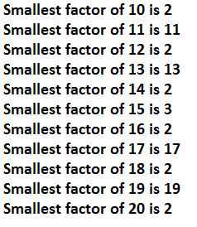
public class BlockLambdaDemo {
public static void main(String[] args) {
// TODO Auto-generated method stub
NumericFunc smallestF = (n)->{
int result = 1;
n = Math.abs(n);
for(int i = 2; i <= n; i++)
if(n % i == 0) {
result = i; break;
}
return result;
};
for(int j = 10; j <= 20; j++) {
System.out.print("Smallest factor of " + j);
System.out.println(" is " + smallestF.func(j));
}
}
}

Slide 18
Generic Functional Interfaces
A lambda expression, itself, cannot specify type parameters. However, the functional interface associated with a lambda expression can be generic.
interface SomeTest<T> {
boolean test(T m, T n);
}

Slide 19
public class GenericFunctionInterfaceDemo {
public static void main(String[] args) {
// TODO Auto-generated method stub
SomeTest<Integer> isFactor = (n,d) ->n%d==0;
if(isFactor.test(10, 2))
System.out.println("2 is a factor of 10");
System.out.println();
SomeTest<Double> isFactorD = (n,d)->n%d==0;
if(isFactorD.test(212.0, 4.0))
System.out.println("4.0 is a factor of 212.0");
System.out.println();
SomeTest<String> isIn = (a,b)->a.indexOf(b) != -1;
String str = "Generic Functional Interface";
System.out.println("Testing string: " + str);
if(isIn.test(str, "face"))
System.out.println("'face' is found");
else
System.out.println("'face' is not found");
}
}

Slide 20
Lambda Expressions and Variable Capture
Variables defined by the enclosing scope of a lambda expression are accessible within the lambda expression.
A lambda expression also has access to this (both explicitly and implicitly), which refers to the invoking instance of the lambda expression’s enclosing class.

Slide 21

Lambda Modifying an Instance Variable
interface MyFunc {
int func(int n);
}
public class VarCapture0 {
public static void main(String[] args) {
// TODO Auto-generated method stub
MyClass my = new MyClass(10);
my.print();
}
}
public class MyClass {
private int x;
MyClass(){x = 0;}
MyClass(int x){this .x = x;}
void print() {
MyFunc myLambda1 = (x)-> x + this.x;
MyFunc myLambda2 = (a)->{
x++;
return a + x;
};
x *= 2;
System.out.println("x is " + x);
System.out.println("myLambda1 is " + myLambda1.func(8));
System.out.println("myLamdba2 is " + myLambda2.func(8));
}
}

Slide 22
Lambda Expressions and Variable Capture
However, when a lambda expression uses a local variable from its enclosing scope, a special situation is created that is referred to as a variable capture.
In this case, a lambda expression may only use local variables that are effectively final. An effectively final variable is one whose value does not change after it is first assigned.
There is no need to explicitly declare such a variable as final, although doing so would not be an error.

Slide 23
interface MyFunc {
int func(int n);
}
public class MyClass {
MyClass(){}
void print() {
//Now x is declared local
int x = 10;
MyFunc myLambda = (a)->{
//Error, cannot change x value
x++;
return a + x;
};
//Error, cannot change x value
x *= 2;
System.out.println("x is " + x);
System.out.println("myLamdba is " + myLambda.func(8));
}
}

Slide 24
Throw an Exception from Within a Lambda Expression
A lambda expression can throw an exception. If it throws a checked exception, then that exception must be compatible with the exception(s) listed in the throws clause of the abstract method in the functional interface.

Slide 25
public interface MyIOAction {
boolean ioAction(Reader rdr) throws IOException;
}
public class LambdaExceptionDemo {
public static void main(String[] args) {
// TODO Auto-generated method stub
MyIOAction myIO = (rdr)->{
int len;
while((len = rdr.read()) != -1) {
System.out.print((char)len);
}
return true;
};
try {
myIO.ioAction(new FileReader("src/LambdaExceptionDemo.java"));
}catch(IOException exc) {
exc.printStackTrace();
}
}
}

Slide 26
The Runnable Functional Interface
As we know before, the Runnable interface has only one method run(), thus it is an functional interface. We can apply the lambda expression on it to create threads.
As lambda expression is unable to modify the local variables, we can define a static variable in the main class, and modify it within the scope of lambda code block.

Slide 27
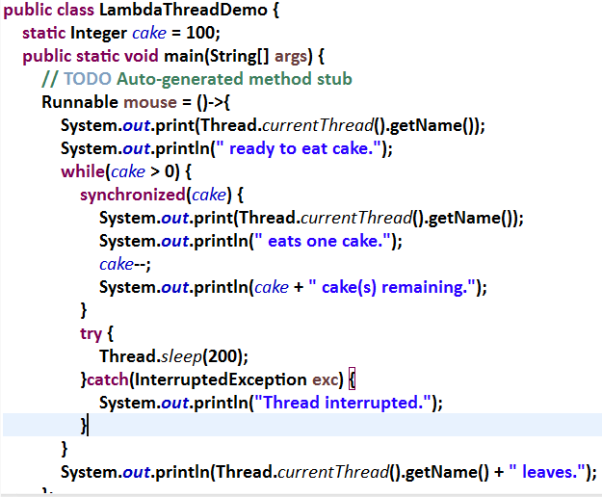

Slide 28
Method References
There is an important feature related to lambda expressions called the method reference. A method reference provides a way to refer to a method without executing it. It relates to lambda expressions because it, too, requires a target type context that consists of a compatible functional interface.

Slide 29
Method References to static Methods
A method reference to a static method is created by specifying the method name preceded by its class name, using this general syntax:
ClassName::methodName
Notice that the class name is separated from the method name by a double colon. The :: is a separator that was added to Java by JDK 8 expressly for this purpose. This method reference can be used anywhere in which it is compatible with its target type.

Slide 30

public class MethodRefDemo {
static boolean numTest(IntPredicate p, int v) {
return p.test(v);
}
public static void main(String[] args) {
// TODO Auto-generated method stub
boolean result;
result = numTest(MyIntPredicates::isPrime,17);
if(result) System.out.println("17 is prime.");
result = numTest(MyIntPredicates::isEven,12);
if(result) System.out.println("12 is even.");
result = numTest(MyIntPredicates::isPositive,11);
if(result) System.out.println("11 is positive.");
}
}
public interface IntPredicate {
boolean test(int n);
}
public class MyIntPredicates {
static boolean isPrime(int n) {
if(n<2) return false;
for(int i = 2; i <= Math.sqrt(n); i++)
if(n%i == 0) return false;
return true;
}
static boolean isEven(int n) {
return n % 2 == 0;
}
static boolean isPositive(int n) {
return n>0;
}
}

Slide 31
Method References to Instance Methods
A reference to an instance method on a specific object is created by this basic syntax:
objRef::methodName

Slide 32
public class MethodRefDemo2 {
public static void main(String[] args) {
// TODO Auto-generated method stub
boolean result;
MyIntNum myNum = new MyIntNum(12);
MyIntNum myNum2 = new MyIntNum(16);
IntPredicate ip = myNum::isFactor;
result = ip.test(3);
if(result) System.out.println("3 is a factor of " + myNum.getNum());
ip = myNum2::isFactor;
result = ip.test(3);
if(result) System.out.println("3 is a factor of " + myNum2.getNum());
}
}
public interface IntPredicate {
boolean test(int n);
}
class MyIntNum {
private int v;
MyIntNum(int x){v = x;}
int getNum() {return v;}
boolean isFactor(int n) {
return v % n == 0;
}
}

Slide 33
Method References to Instance Methods
It is also possible to handle a situation in which you want to specify an instance method that can be used with any object of a given class—not just a specified object. In this case, you will create a method reference as shown here:
ClassName::instanceMethodName
With this form, the first parameter of the functional interface matches the invoking object and the second parameter matches the parameter (if any) specified by the method.

Slide 34
interface MyIntPredicate {
boolean test(MyIntNum mv, int n);
}
public class MethodRefDemo3 {
public static void main(String[] args) {
// TODO Auto-generated method stub
boolean result;
MyIntNum myNum = new MyIntNum(12);
MyIntNum myNum2 = new MyIntNum(16);
MyIntPredicate inp = MyIntNum::isFactor;
result = inp.test(myNum, 3);
if(result) System.out.println(" 3 is a factor of " + myNum.getNum());
result = inp.test(myNum2, 3);
if(result) System.out.println(" 3 is a factor of " + myNum2.getNum());
}
}
class MyIntNum {
private int v;
MyIntNum(int x){v = x;}
int getNum() {return v;}
boolean isFactor(int n) {
return v % n == 0;
}
}

Slide 35
Note
A method reference can use the keyword super to refer to a superclass version of a method. The general forms of the syntax are super::methodName and typeName.super::methodName. In the second form, typeName must refer to the enclosing class or a superinterface.

Slide 36
Constructor References
Similar to the way that you can create references to methods, you can also create references to constructors. Here is the general form of the syntax that you will use:
classname::new
This reference can be assigned to any functional interface reference that defines a method compatible with the constructor.

Slide 37
interface MyFunc {
MyClass func(String s);
}
class MyClass {
private String str;
MyClass(){str = "";}
MyClass(String s){str = s;}
String getStr() {return str;}
}
public class ConstructorRefDemo {
public static void main(String[] args) {
// TODO Auto-generated method stub
MyFunc myClassCons = MyClass::new;
MyClass mc = myClassCons.func("Testing");
System.out.println("str in mc is " + mc.getStr());
}
}

Slide 38
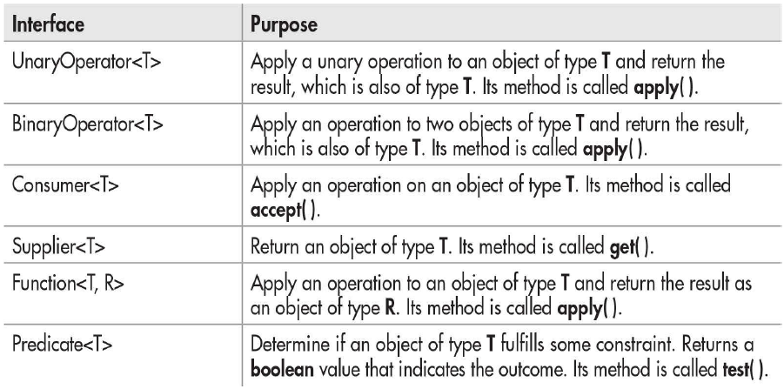
Java’s Predefined Functional Interfaces

Slide 39
Functional Interface Predicate<T> Demo
public class UsePredicateInterface {
public static void main(String[] args) {
// TODO Auto-generated method stub
Predicate<Integer> isEven = (n)->n%2==0;
for(int i = 1; i <= 5; i++)
if(isEven.test(i)) System.out.println(i + " is even.");
else System.out.println(i + " is odd.");
Predicate<String> contains = (str)->str.contains("man");
if(contains.test("policeman"))
System.out.println("policeman contains man.");
}
}

Slide 40
Application of Lambda
The Collections.sort method provides another overloaded function to specify a Comparator<T> interface reference as an criteria.
sort(List<T> list, Comparator<T> cmp)
The Comparable<T> is a functional interface, which contains a method compare:
public int compare(T t1, T t2);
If it returns a positive value, then t1>t2; a negative value, then t1 < t2; zero for t1=t2.

Slide 41
Sorting an Array in Descendant Order without Lambda Expression
public class SortDemo {
public static void main(String[] args) {
// TODO Auto-generated method stub
Integer[] a = {1,4,2,8,5,7};
ArrayList<Integer> alist = new ArrayList<>(Arrays.asList(a));
Collections.sort(alist, new Comparator<Integer>(){
@Override
public int compare(Integer i1, Integer i2) {
return i2.compareTo(i1);
}
});
System.out.println(alist);
}
}

Slide 42
Sorting an Array in Descendant Order Using Lambda Expression
public class SortDemo2 {
public static void main(String[] args) {
// TODO Auto-generated method stub
Integer[] a = {1,4,2,8,5,7};
ArrayList<Integer> alist = new ArrayList<>(Arrays.asList(a));
Collections.sort(alist, (i1,i2)->i2.compareTo(i1));
System.out.println(alist);
}
}

Slide 43
Java Stream
Since JDK8, a new type of data processing mechanism is provided, called Stream. It does not actually store collection of data, but is like a kind of advanced Iterator.
The Iterator<T> object, as we know, is able to traverse the elements of a Collection<T> object from first to last, but Stream can perform more powerful work.

Slide 44
The Stream<T> Interface
The Stream<T> interface is at the core position of all stream operators. For example, the following example can filter out all the even numbers.
public class StreamDemo {
public static void main(String[] args) {
// TODO Auto-generated method stub
Stream<Integer> stream = Stream.of(1,2,3,4,5,6,7,8);
stream = stream.filter((n)->n%2==0);
ArrayList<Integer> list1 = stream.collect(Collectors.toCollection(ArrayList::new));
for(Integer value: list1)
System.out.print(value + " ");
}
}
Create a stream
Filter
Convert to an ArrayList

Slide 45
Create an Stream Instance
There are two approaches to create an stream instance, the first is to use the of static method.
Stream<Integer> istream = Stream.of(1,2,3,4,5,6);
Stream<String> sstream = Stream.of(“hello”);
This approach returns a stream with a limited number of elements.

Slide 46
Create an Stream Instance
The second approach is to use the generate method from the object that implemented the Supplier<T> functional interface. The method is as follows:
generate(Supplier<T> s)
As a result, you can create an anonymous reference of the Supplier interface:
Stream<Double> stream = Stream.generate(new Supplier<Double>(){
@Override
public Double get(){
return Math.random();
}
});

Slide 47
Create an Stream Instance
Of course, you can create such anonymous instance using the lambda expression or method reference:
Stream<Double> stream = Stream.generate(()->Math.random());
Stream<Double> stream = Stream.generate(Math::random);
Attention, the generate method will actually create an unlimited length stream. Although unlimited, the stream is lazy-loaded, thus it is always with the limit() method.

Slide 48
Convert an Array or Collection to the Stream
You can convert an array to the stream using the following approach:
Integer a[] = {1,2,3,4,5,6};
Stream<Integer> stream = Stream.of(a);
Stream<Integer> stream2 = Arrays.stream(a);
You can convert a collection to the stream using the following approach:
ArrayList<Integer> alist = new ArrayList<Integer>();
HashSet<Integer> hset = new HashSet<Integer>();
Stream<Integer> stream = alist.stream();
Stream<Integer> stream2 = hset.stream();

Slide 49
Convert Stream to an Array or a Collection
The examples are as follows:
Stream<Integer> stream = Stream.of(“1,2,3,4,5,6”);
Integer a[] = stream.toArray(String[]::new);
List<Integer> list1 = stream.collect(Collectors.toList());
ArrayList<Integer> list2 = stream.collect(Collector.toCollection(ArrayList::new());
Set<Integer> set1 = stream.collect(Collectors.toSet());

Slide 50
Operational Methods for a Stream
Method Name | Description
long count() | Returns the count of elements in the stream.
void forEach(Consumer<T> action) | Performs an action for each element in the stream.
Stream<T> distinct() | Returns a stream without duplicated values.
Stream<T> limit(long maxsize) | Returns a stream with top maxsize elements.
Stream<T> peek(Consumer<T> action) | Similar to forEach, but the return value is a new stream.
Stream<T> filter(Predicate<T> predicate) | Returns a stream that consists of elements satisfying the predicate.
Stream<R> map(Function<T,R> mapper) | Returns a stream that consists of results of the given mapped function.

Slide 51
Operational Methods for a Stream
Attention: After you call the operational methods, the stream will closed immediate, thus forEach and count should be called at the very end. Otherwise, if the method returns a Stream<T> object, a new stream will be created.

Slide 52
public class StreamDemo2 {
public static void main(String[] args) {
// TODO Auto-generated method stub
Integer a[] = {1,2,3,4,5,6,7,8};
Stream<Integer> is = Stream.of(a);
is.forEach((e)->System.out.print(e + " "));
System.out.println();
is = Stream.of(a);
is.limit(5).forEach((e)->System.out.print(e + " "));
System.out.println();
is = Stream.of(a);
is.filter((n)->n%2==0).forEach(System.out::println);
System.out.println("------");
is = Stream.of(a);
is.map((e)->e*e).forEach((e)->System.out.print(e + " "));
System.out.println();
String str[] = {"hello","friend","finally","today"};
Stream<String> sstream = Stream.of(str);
long count = sstream.map(String::toUpperCase).peek(System.out::println)
.filter((s)->s.startsWith("F")).count();
System.out.println("Result count is: " + count);
}
}

Slide 53
A Comprehensive Example
Suppose a student contains four attributes: name, sex(0 for male and 1 for female), age, score. Please use the Stream to perform the following tasks:
Find out all the girls whose age > 18 and surname is “李”.
Add 5% of score to all the students whose original score is below 60.

Slide 54
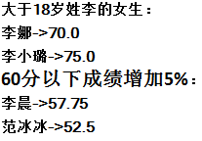
public class StudentStreamDemo {
public static void main(String[] args) {
// TODO Auto-generated method stub
ArrayList<Student> stuList = new ArrayList<Student>() {
{
add(new Student("黄世仁",20,true,65.0));
add(new Student("李娜",19,false,70.0));
add(new Student("李晨",18,true,55.0));
add(new Student("范冰冰",17,false,50.0));
add(new Student("李小璐",20,false,75.0));
add(new Student("杨白劳",21,true,62.0));
}
};
System.out.println("大于18岁姓李的女生：");
Stream<Student> stream = stuList.stream();
stream.filter((e)->e.getAge()>18).filter((e)->e.getSex()==false)
.filter((e)->e.getName().startsWith("李"))
.forEach((e)->System.out.println(e.getName() + "->" + e.getScore()));
System.out.println("60分以下成绩增加5%：");
stream = stuList.stream();
stream.filter((e)->e.getScore()<60)
.peek((e)->e.setScore(e.getScore()*1.05))
.forEach((e)->System.out.println(e.getName() + "->" + e.getScore()));
}
}

